Slide 1

CONFIDENTIAL — DO NOT PRINT OR COPY — THESE MATERIALS ARE FOR YOUR VIEWING ONLY AND ARE NOT INTENDED FOR DISTRIBUTION; FOR PRESENTATION PURPOSES ONLY.
Notes:
Speak to slide.

Slide 2

AN ONGOING COMMITMENT TO INNOVATION
Bausch + Lomb continues to go above and beyond to offer innovative eye care, first by identifying a need among the patient population and developing a forward-thinking solution to address that need.
Notes:
Bausch + Lomb continues to go above and beyond to offer innovative eye care, first by identifying a need among the patient population and developing a forward-thinking solution to address that need.

Slide 3
PATIENTS WONDER WHERE THEY CAN GO NEXT
A custom soft lens could be that missing puzzle piece you are looking for.
Patients in your practice may have been told that they can’t wear contact lenses or that there are no contact lenses available to fit their vision needs.
As an ECP, you may have been told by consultants that there is nothing else you can do to fit your high-prescription patients.
Notes:
Patients in your practice may have been told that they can’t wear contact lenses or that there are no contact lenses available to fit their vision needs.
As an ECP, you may have been told by consultants that there is nothing else you can do to fit your high-prescription patients.
A custom soft lens could be that missing puzzle piece you are looking for.

Slide 4
THE COST OF CONTACT LENS DROPOUT
Rumpakis estimates that each contact lens dropout represents approximately $24,000 a year in lost revenue²
In a 2015 first-year retention study conducted in the UK with 524 contact lens patients:
Approximately 26% of new contact lens wearers dropped out of wear within the first year¹
For 71% of dropouts, no alternative lens or management strategy had been tried¹
REFERENCES: 1. Sulley A, Young G, Hunt C. Factors in the success of new contact lens wearers. Cont Lens Anterior Eye. 2017;40(1):15-24. doi:10.1016/j.clae.2016.10.002
2. Pucker AD, Tichenor AA. A Review of Contact Lens Dropout. Clin Optom (Auckl). 2020;12:85-94. https://doi.org/10.2147/OPTO.S198637
Notes:
In a 2015 first-year retention study conducted in the UK with 524 contact lens patients, approximately 26% of new contact lens wearers dropped out of wear within the first year. [REF-NPR-3164-REF 31 Sulley 2017 Factors in the success of new contact lens wearers/PDF pg. 7, “Discussion” section/para 2, lines 1-3]
For 71% of dropouts, no alternative lens or management strategy had been tried. [REF-NPR-3164-REF 31 Sulley 2017 Factors in the success of new contact lens wearers/PDF pg. 1, “Abstract” section/lines 11-13]
Rumpakis estimates that each contact lens dropout represents approximately $24,000 a year in lost revenue. [REF-MTB-0070-Rumpakis/pg1/final paragraph, lines 1-3]

Slide 5
If we could reduce the dropout rate by as little as 3.5% yearly between 2020 and 2040, we could double the number of contact lens wearers in our practices¹
REFERENCE: 1. Van der Worp E, Wolffsohn JS, Jones L. Dropping the dropout rate. Contact Lens Spectrum. 2020 May;35:36-40, 42, 43.
https://www.clspectrum.com/issues/2020/may-2020/dropping-the-dropout-rate
Notes:
Experts believe if we could reduce the dropout rate by as little as 3.5% yearly between 2020 and 2040, we could double the number of contact lens wearers in our practices. [REF-NPR-3470 Dropping-the-dropout-rate/page2/para3]

Slide 6

MAKING A CASE FOR CUSTOM SOFT LENSES
When standard lens parameters or alternative lens modalities fall short, custom soft lenses may be able to fill in the gaps.
  Manufactured in a wide range of adjustable base curves and parameters
  Suitable for practitioners of all fitting levels
  Delivers vision outcomes driven by precise, tailored treatment
  Opens door for beyond standard or high-prescription patient
Notes:
When standard lens parameters or alternative lens modalities fall short, custom soft lenses may be able to fill in the gaps.
Manufactured in a wide range of adjustable base curves and parameters [REF-MTB-0203-REVIVE Package Insert/description]
Suitable for practitioners of all fitting levels
Delivers vision outcomes driven by precise, tailored treatment
Opens door for beyond standard or high-prescription patients [REF-REV-0002/PDF pg 1/indication]s

Slide 7

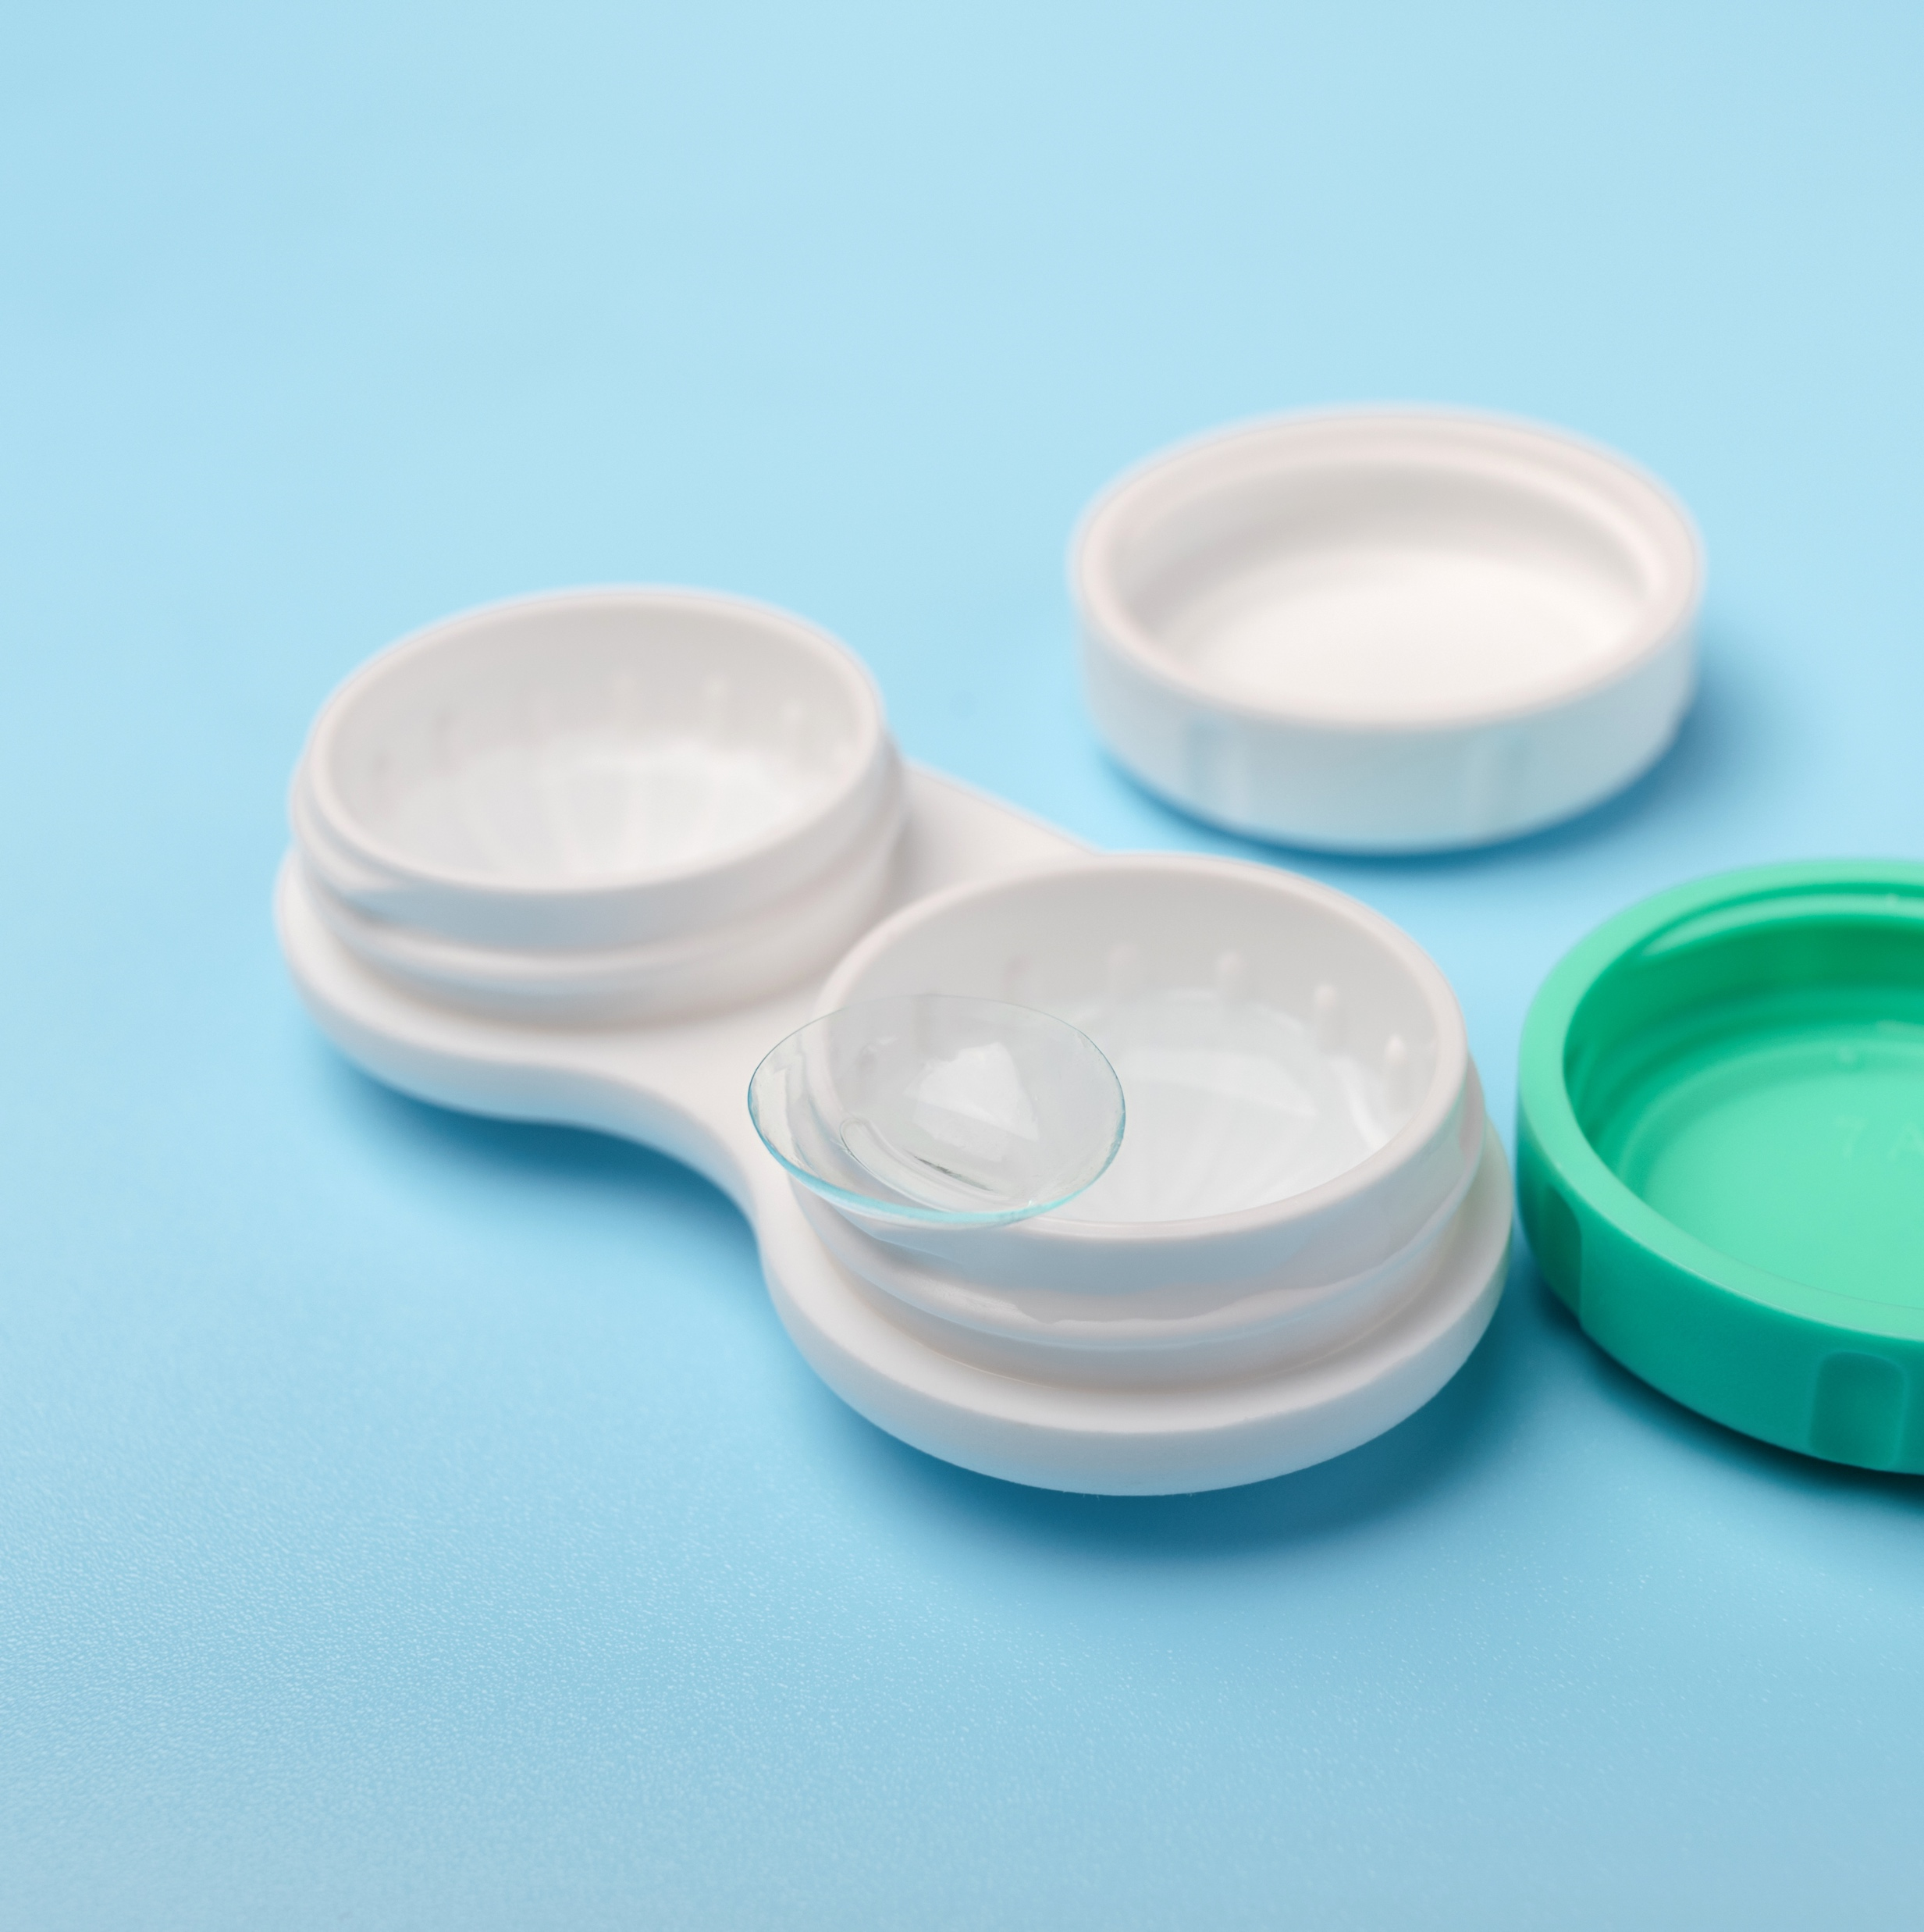
MAKING A CASE FOR CUSTOM SOFT LENSES
Patients' eyes differ in shape and size. Custom soft lenses can remove guesswork in lens fitting as they:
  Offer an expanded range of base curve and parameter availability
  Eliminate the “one-size-fits-all” philosophy
  Are readily accessible to practitioners and
  their patients
Notes:
Patients' eyes differ in shape and size. Custom soft lenses can remove guesswork in lens fitting as they:
Offer an expanded range of base curve and parameter availability [REF-REV-0002/PDF pg 1/Description]
Eliminate the “one-size-fits-all” philosophy [REF-REV-0002/PDF pg 1/Indications]
Are readily accessible to practitioners and their patients [REF-REV-0002/PDF pg 1/Indications]

Slide 8
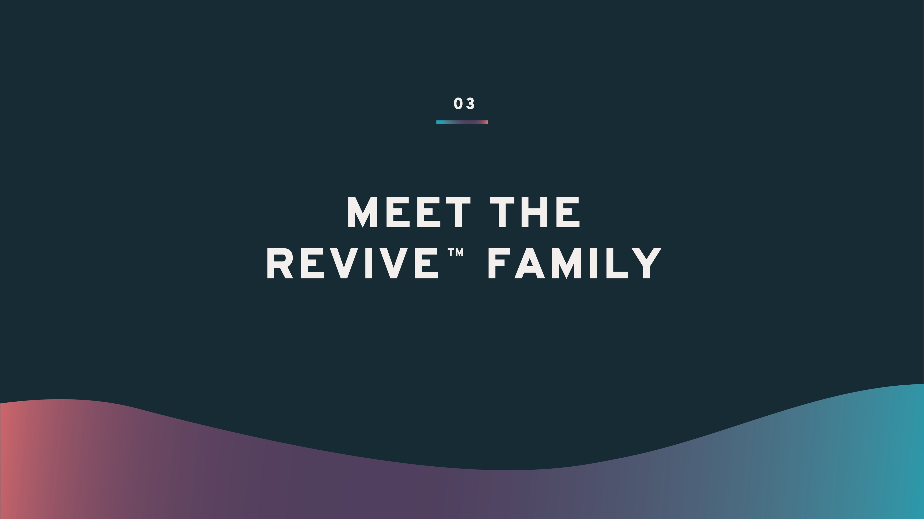

MEET
CONFIDENTIAL — DO NOT PRINT OR COPY — THESE MATERIALS ARE FOR YOUR VIEWING ONLY AND ARE NOT INTENDED FOR DISTRIBUTION; FOR PRESENTATION PURPOSES ONLY.
Notes:
Speak to slide.

Slide 9
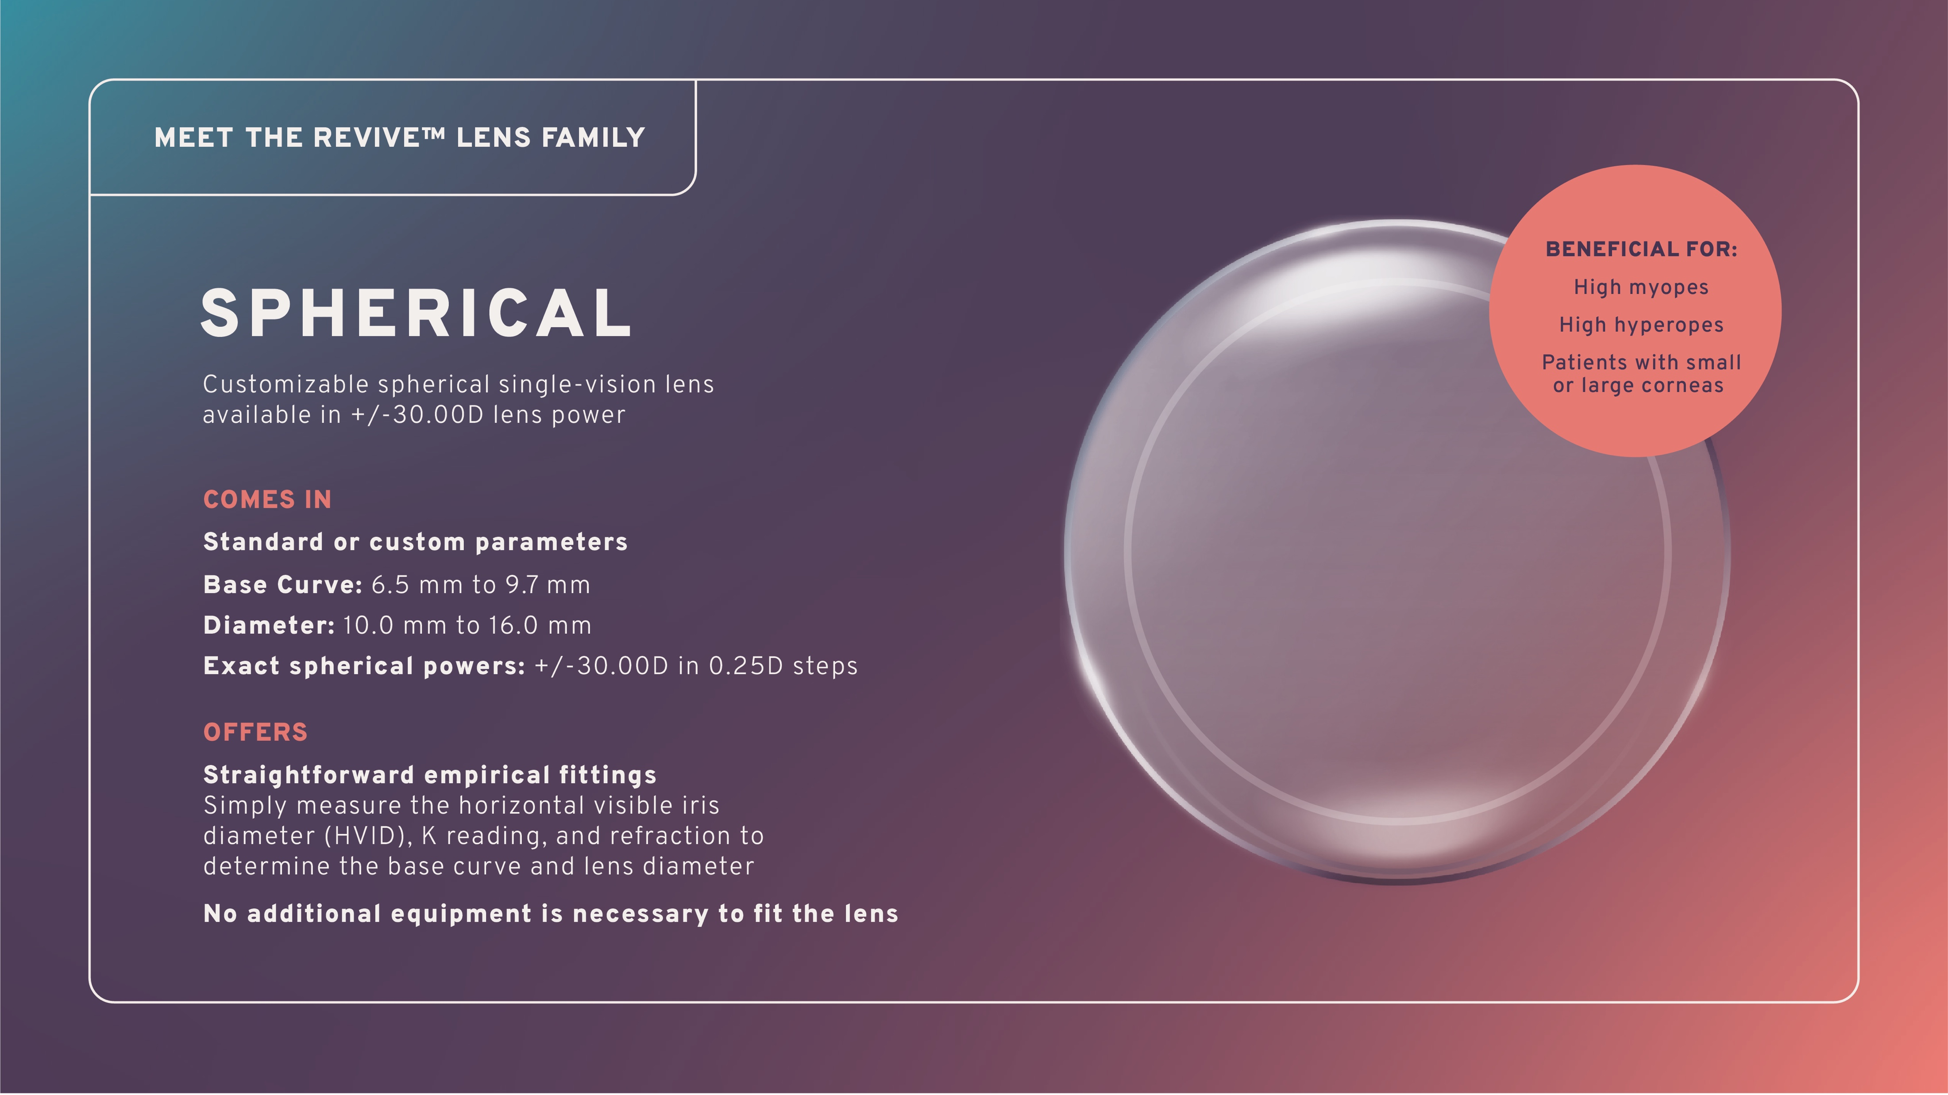
CONFIDENTIAL — DO NOT PRINT OR COPY — THESE MATERIALS ARE FOR YOUR VIEWING ONLY AND ARE NOT INTENDED FOR DISTRIBUTION; FOR PRESENTATION PURPOSES ONLY.
Notes:
Revive™ spherical is a customizable spherical single-vision lens available in +/-30.00D lens power.
Beneficial for:
High myopes
High hyperopes
Patients with small or large corneas
Comes in standard or custom parameters:
Base Curve: 6.5 mm to 9.7 mm
Diameter: 10.0 mm to 16.0 mm
Exact spherical powers: +/-30.00D in 0.25D steps
Offers straightforward empirical fittings
- Simply measure the horizontal visible iris diameter (HVID), K reading, and refraction to determine the base curve and lens diameter
- No additional equipment is necessary to fit the lens

Slide 10
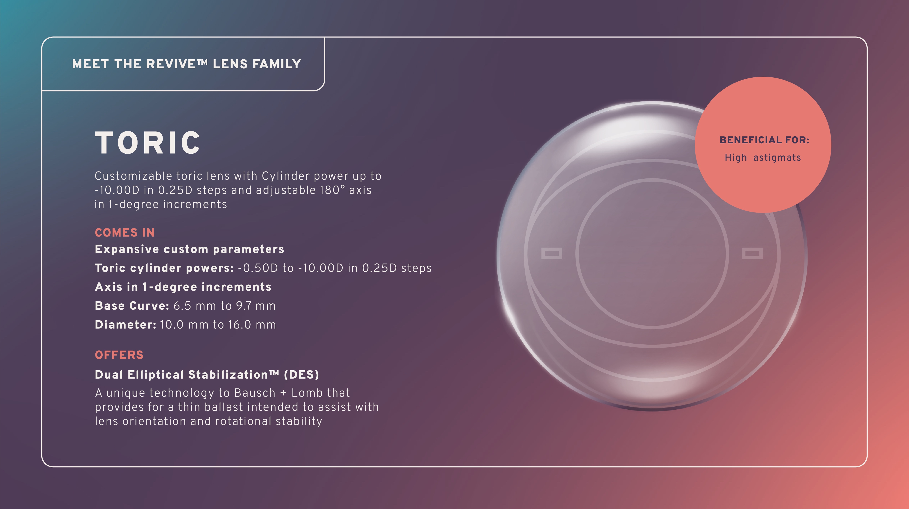
CONFIDENTIAL — DO NOT PRINT OR COPY — THESE MATERIALS ARE FOR YOUR VIEWING ONLY AND ARE NOT INTENDED FOR DISTRIBUTION; FOR PRESENTATION PURPOSES ONLY.
Notes:
Revive™ toric is a customizable toric lens with Cylinder power up to -10.00D in 0.25D steps and adjustable 180° axis in 1-degree increments.
Beneficial for:
- High Astigmats
Comes in expansive custom parameters:
Toric cylinder powers: -0.50D to -10.00D in 0.25D steps
Axis in 1-degree increments
Base Curve: 6.5 mm to 9.7 mm
Diameter: 10.0 mm to 16.0 mm
Offers Dual Elliptical Stabilization™ (DES)
A unique technology to Bausch + Lomb that provides for a thin ballast intended to assist with lens orientation and rotational stability

Slide 11
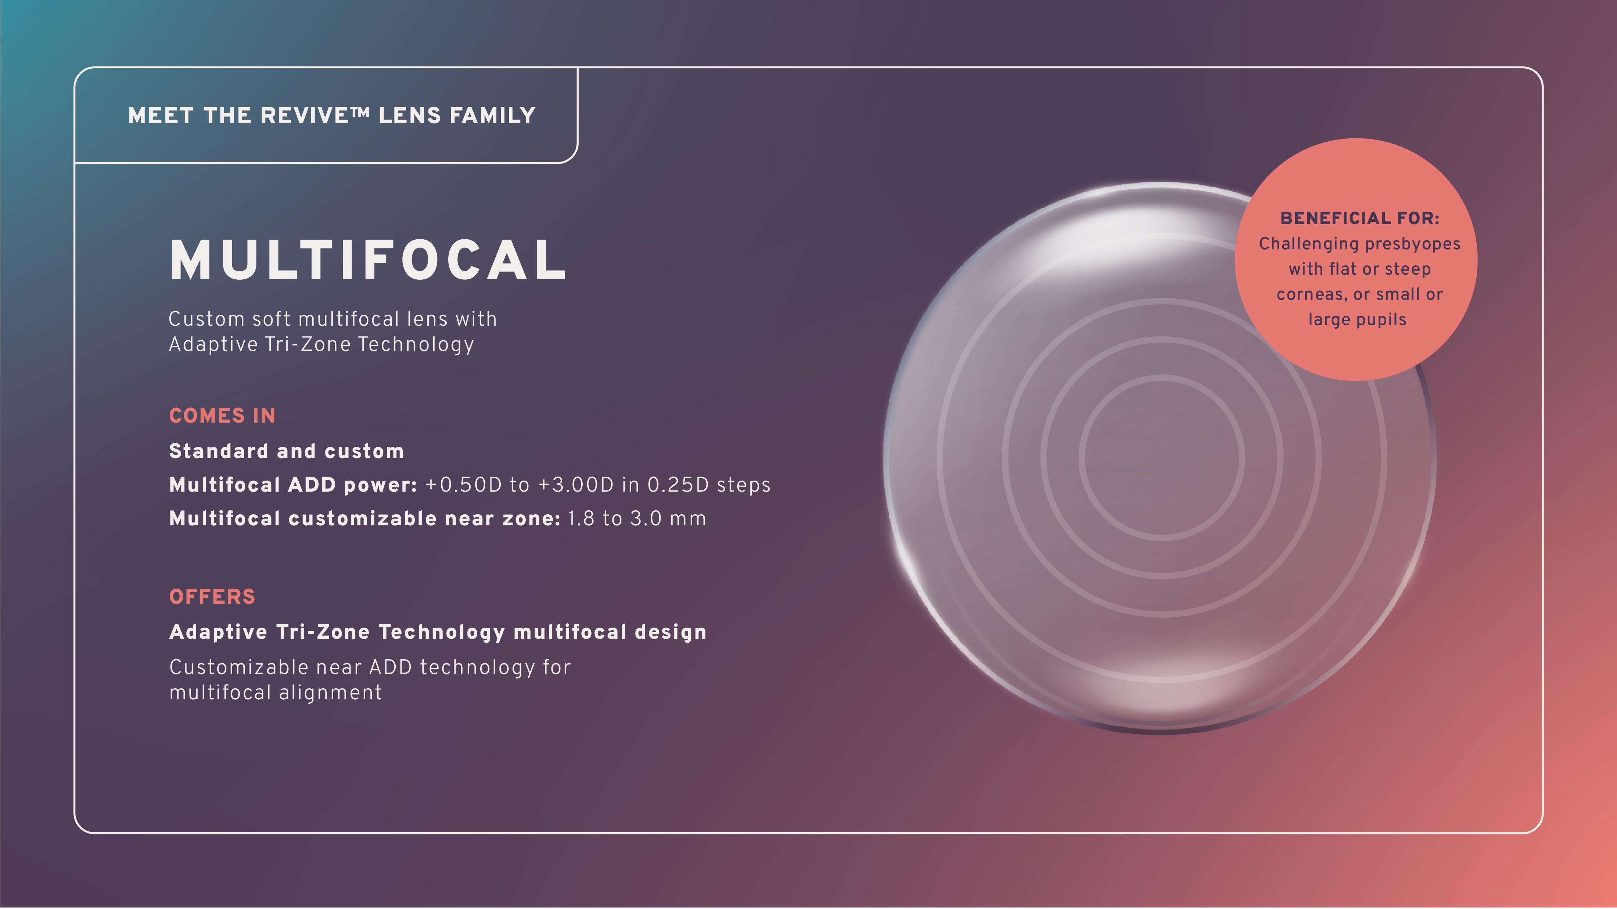
CONFIDENTIAL — DO NOT PRINT OR COPY — THESE MATERIALS ARE FOR YOUR VIEWING ONLY AND ARE NOT INTENDED FOR DISTRIBUTION; FOR PRESENTATION PURPOSES ONLY.
Notes:
Revive™ multifocal is a custom soft multifocal lens with Adaptive Tri-Zone Technology.
Beneficial for:
- Challenging presbyopes with flat or steep corneas, or small or large pupils
Comes in standard and custom parameters
Multifocal ADD power: +0.50D to +3.00D in 0.25D steps
Multifocal customizable near zone: 1.8 to 3.0 mm
Offers Adaptive Tri-Zone Technology multifocal design
Customizable near ADD technology for multifocal alignment

Slide 12
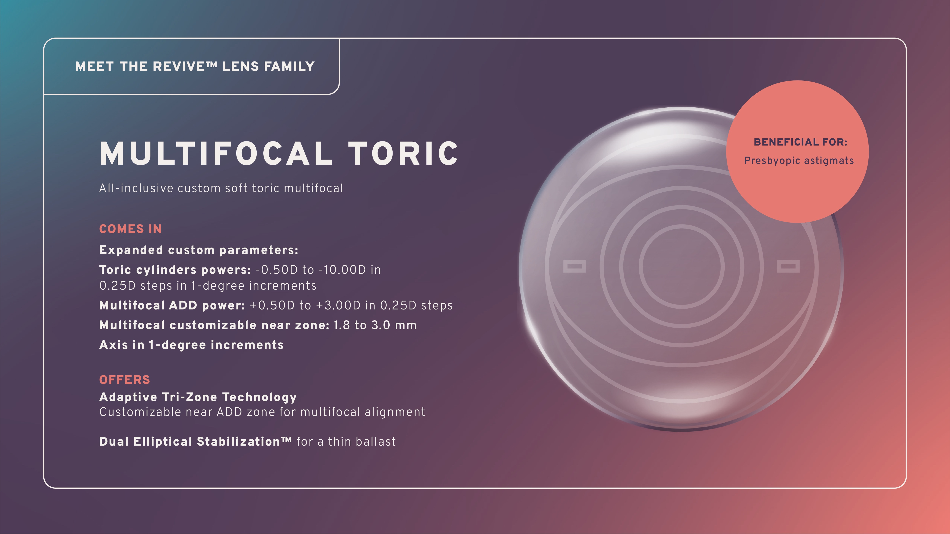
CONFIDENTIAL — DO NOT PRINT OR COPY — THESE MATERIALS ARE FOR YOUR VIEWING ONLY AND ARE NOT INTENDED FOR DISTRIBUTION; FOR PRESENTATION PURPOSES ONLY.
Notes:
Revive™ multifocal toric is an all-inclusive custom soft toric multifocal.
Beneficial for:
- Presbyopic astigmats
Comes in expanded custom parameters:
Toric cylinders powers: -0.50D to -10.00D in 0.25D steps in 1-degree increments
Multifocal ADD power: +0.50D to +3.00D in 0.25D steps
Multifocal customizable near zone: 1.8 to 3.0 mm
Axis in 1-degree increments
Offers Adaptive Tri-Zone Technology
Customizable near ADD zone for multifocal alignment [REF-REV-0002-PACKAGE INSERT Package Insert/pg2/description/multifocal toric]
Dual Elliptical Stabilization™ for a thin ballast

Slide 13
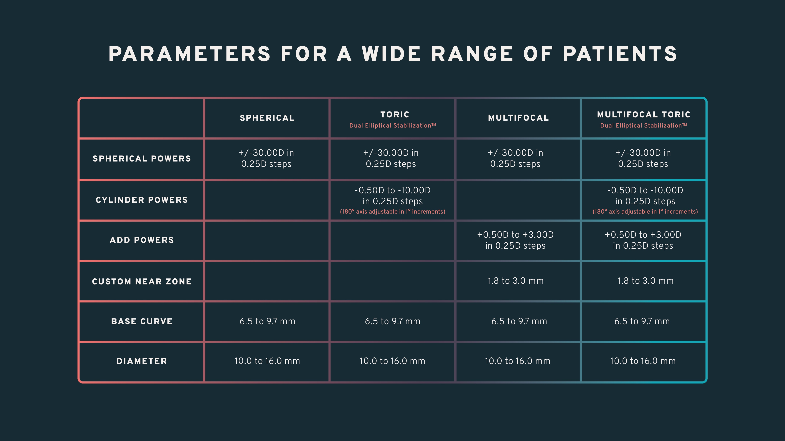
Parameters for a wide range of patients
CONFIDENTIAL — DO NOT PRINT OR COPY — THESE MATERIALS ARE FOR YOUR VIEWING ONLY AND ARE NOT INTENDED FOR DISTRIBUTION; FOR PRESENTATION PURPOSES ONLY.
Notes:
Speak to slide.

Slide 14
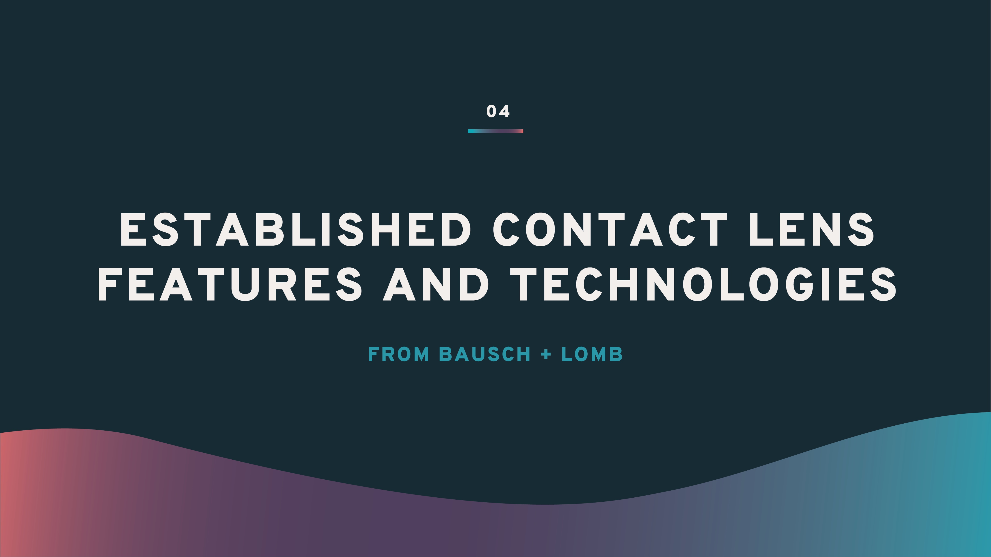
CONFIDENTIAL — DO NOT PRINT OR COPY — THESE MATERIALS ARE FOR YOUR VIEWING ONLY AND ARE NOT INTENDED FOR DISTRIBUTION; FOR PRESENTATION PURPOSES ONLY.
Notes:
Speak to slide.

Slide 15
DUAL ELLIPTICAL STABILIZATION™ (DES)
Uses CAD/CAM tools to precisely control
the shape and position of the lens ballast
Allows for the lens to create the position you desire
Assists with lens orientation and stability
For your astigmats and astigmatic presbyopes,
this means an innovative lens designed to fit their unique parameters.
Dual Elliptical StabilizationTM
Notes:
Revive™ toric and multifocal toric custom soft contact lenses feature Dual Elliptical Stabilization™ (DES), a unique technology to Bausch + Lomb that provides for a thin ballast intended to assist with lens orientation and rotational stability. [REF-REV-0001-DSG-237 (A) Revive - Soft Contact Lens]/anchor: Dual Elliptical Stabilization Functionality
This differs from traditional double slab-off designs where the ballast is created using material that remains after “slabbing off.” [REF-REV-0001-DSG-237 (A) Revive - Soft Contact Lens[9]/design-information/pg1]; [REF-DSG-237 (A) Revive - Soft Contact Lens[9]/Toric-front-surface-description/pg6]
For your astigmatic presbyopes, this means an innovative lens designed to fit their unique parameters.

Slide 16
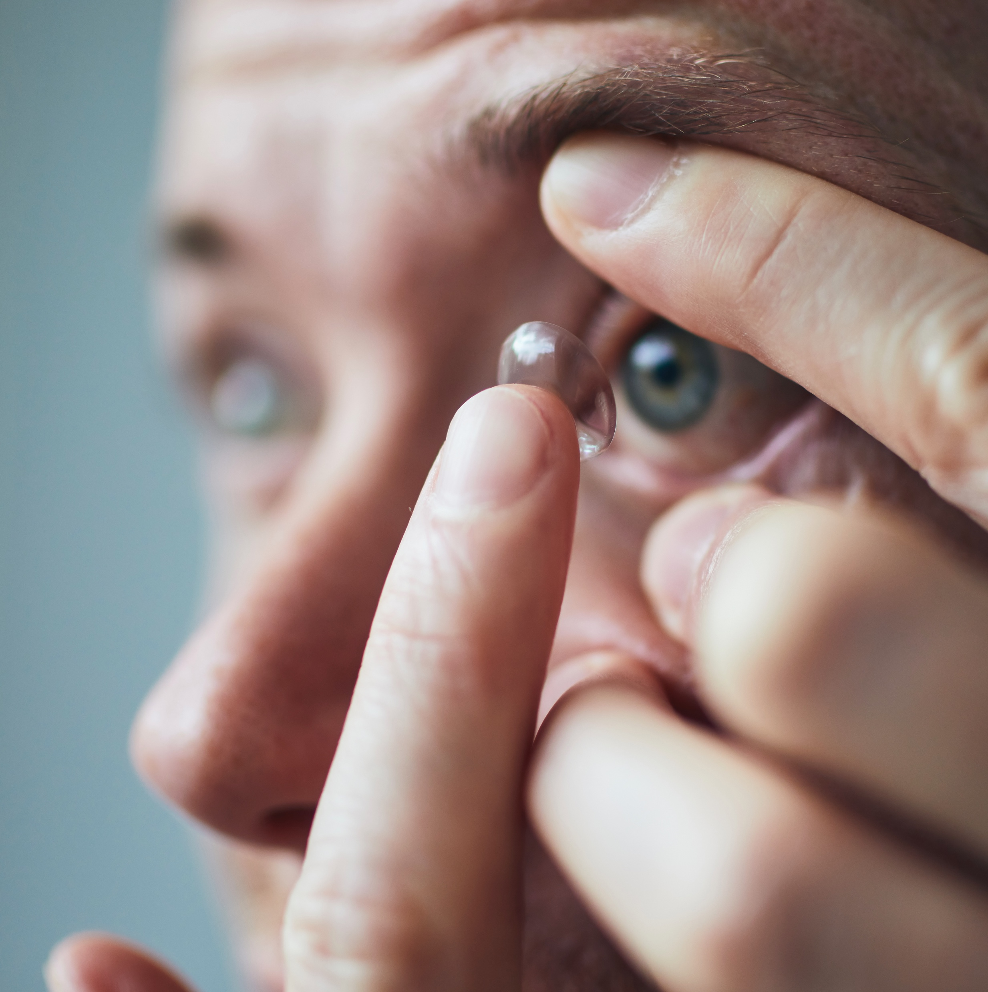
ADAPTIVE
TRI-ZONE TECHNOLOGY
Features a customizable near ADD zone
Near-ADD-zone size can be reduced to fit patients’ pupil size and provide multifocal alignment
For your challenging presbyopes, this means an advanced lens option that accommodates their unique eye shape and size
Notes:
Adaptive Tri-Zone Technology allows for the near-ADD-zone size to be reduced to fit patients’ parameters and provide multifocal alignment. [REF-REV-0001-DSG-237 (A) Revive - Soft Contact Lens/PDF pg 8/Diopter Profile File]
For your challenging presbyopes, this means an advanced lens option that accommodates their unique eye shape and size.

Slide 17

With Revive™, patient and practice benefits go hand in hand.
CONFIDENTIAL — DO NOT PRINT OR COPY — THESE MATERIALS ARE FOR YOUR VIEWING ONLY AND ARE NOT INTENDED FOR DISTRIBUTION; FOR PRESENTATION PURPOSES ONLY.
Notes:
When it comes to implementing Revive™ into your practice, your patient and practice benefits go hand in hand.

Slide 18
SUITABLE FOR PRACTITIONERS OF ALL LEVELS
No matter where you’re at in your fitting journey, Revive™ can be integrated into your practice.
  Consultant order support available as needed
  No additional equipment or fitting set required
  Straightforward empirical fitting process
  Ability to fit to a population of beyond-standard or high-prescription patients
Notes:
No matter where you’re at in your fitting journey, Revive™ can be integrated into your fitting practice.
Consultant order support available as needed
No additional equipment or fitting set required
Straightforward empirical fitting process MTB.0060.USA.22 [Revive Multifocal Fitting Guide/pg 1/Steps 1-4]
Ability to fit to a population of beyond-standard or high-prescription patients [REF-REV-0002/PDF pg 1/Indications]

Slide 19

SET YOUR
PRACTICE APART
Fitting Revive™ can allow you to distinguish your practice in custom lens care.
  Create a name for yourself as a practitioner who is aware of the lens options best suited to your patients
  Become a practice of choice for patients who value a service that meets and understands their needs
  Bring attention to a differentiated service offering
Notes:
Fitting Revive™ can allow you to distinguish your practice in custom lens care.
- Create a name for yourself as a practitioner who is aware of the lens options best suited to your patients
- Become a practice of choice for patients who value a service that meets and understands their needs
- Bring attention to a differentiated service offering

Slide 20
ENCOURAGE PATIENT AND
PRACTICE LOYALTY
Patients who wear custom soft contact lenses can become some of your most loyal patients.
  Offer patients a lens modality they may not have previously considered
  Patient satisfaction encourages them to come back for more
  Display a willingness to go
  the extra mile to address their unique situation
Notes:
Patients who wear custom soft contact lenses can become some of your most loyal patients.
- Offer patients a lens modality they may not have previously considered
- Patient satisfaction encourages them to come back for more
- Display a willingness to go the extra mile to address their unique situation

Slide 21
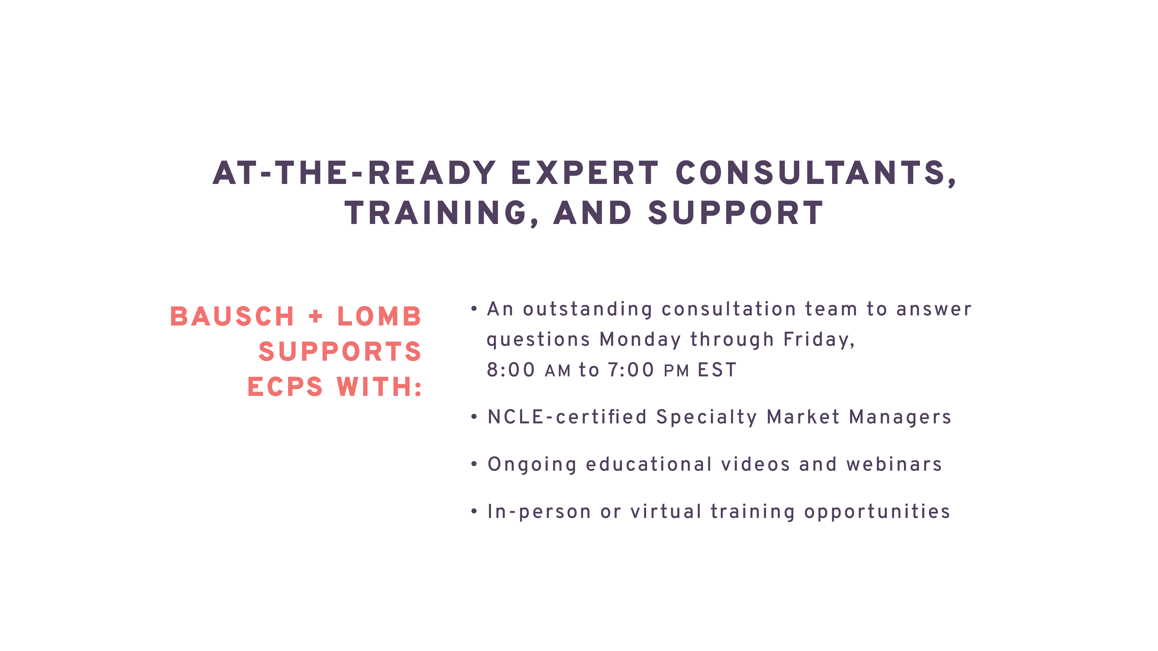
Notes:
Bausch + Lomb supports ECPs with:
- An outstanding consultation team to answer questions Monday through Friday, 8:00 AM to 7:00 PM EST
- NCLE-certified Specialty Market Managers
- Ongoing educational videos and webinars
- In-person or virtual training opportunities

Slide 22
Take a straightforward
approach to custom
lens fitting.
CONFIDENTIAL — DO NOT PRINT OR COPY — THESE MATERIALS ARE FOR YOUR VIEWING ONLY AND ARE NOT INTENDED FOR DISTRIBUTION; FOR PRESENTATION PURPOSES ONLY.
Notes:
Speak to slide.

Slide 23
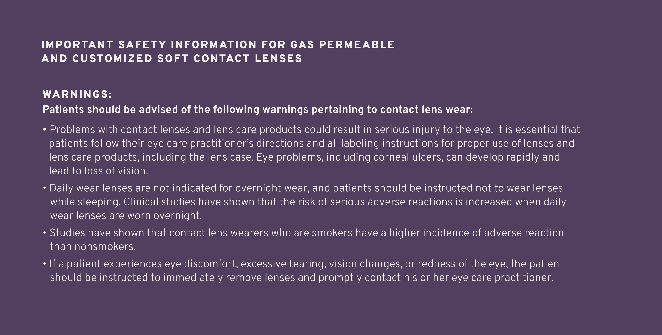

Notes:
Speak to slide.

Slide 24
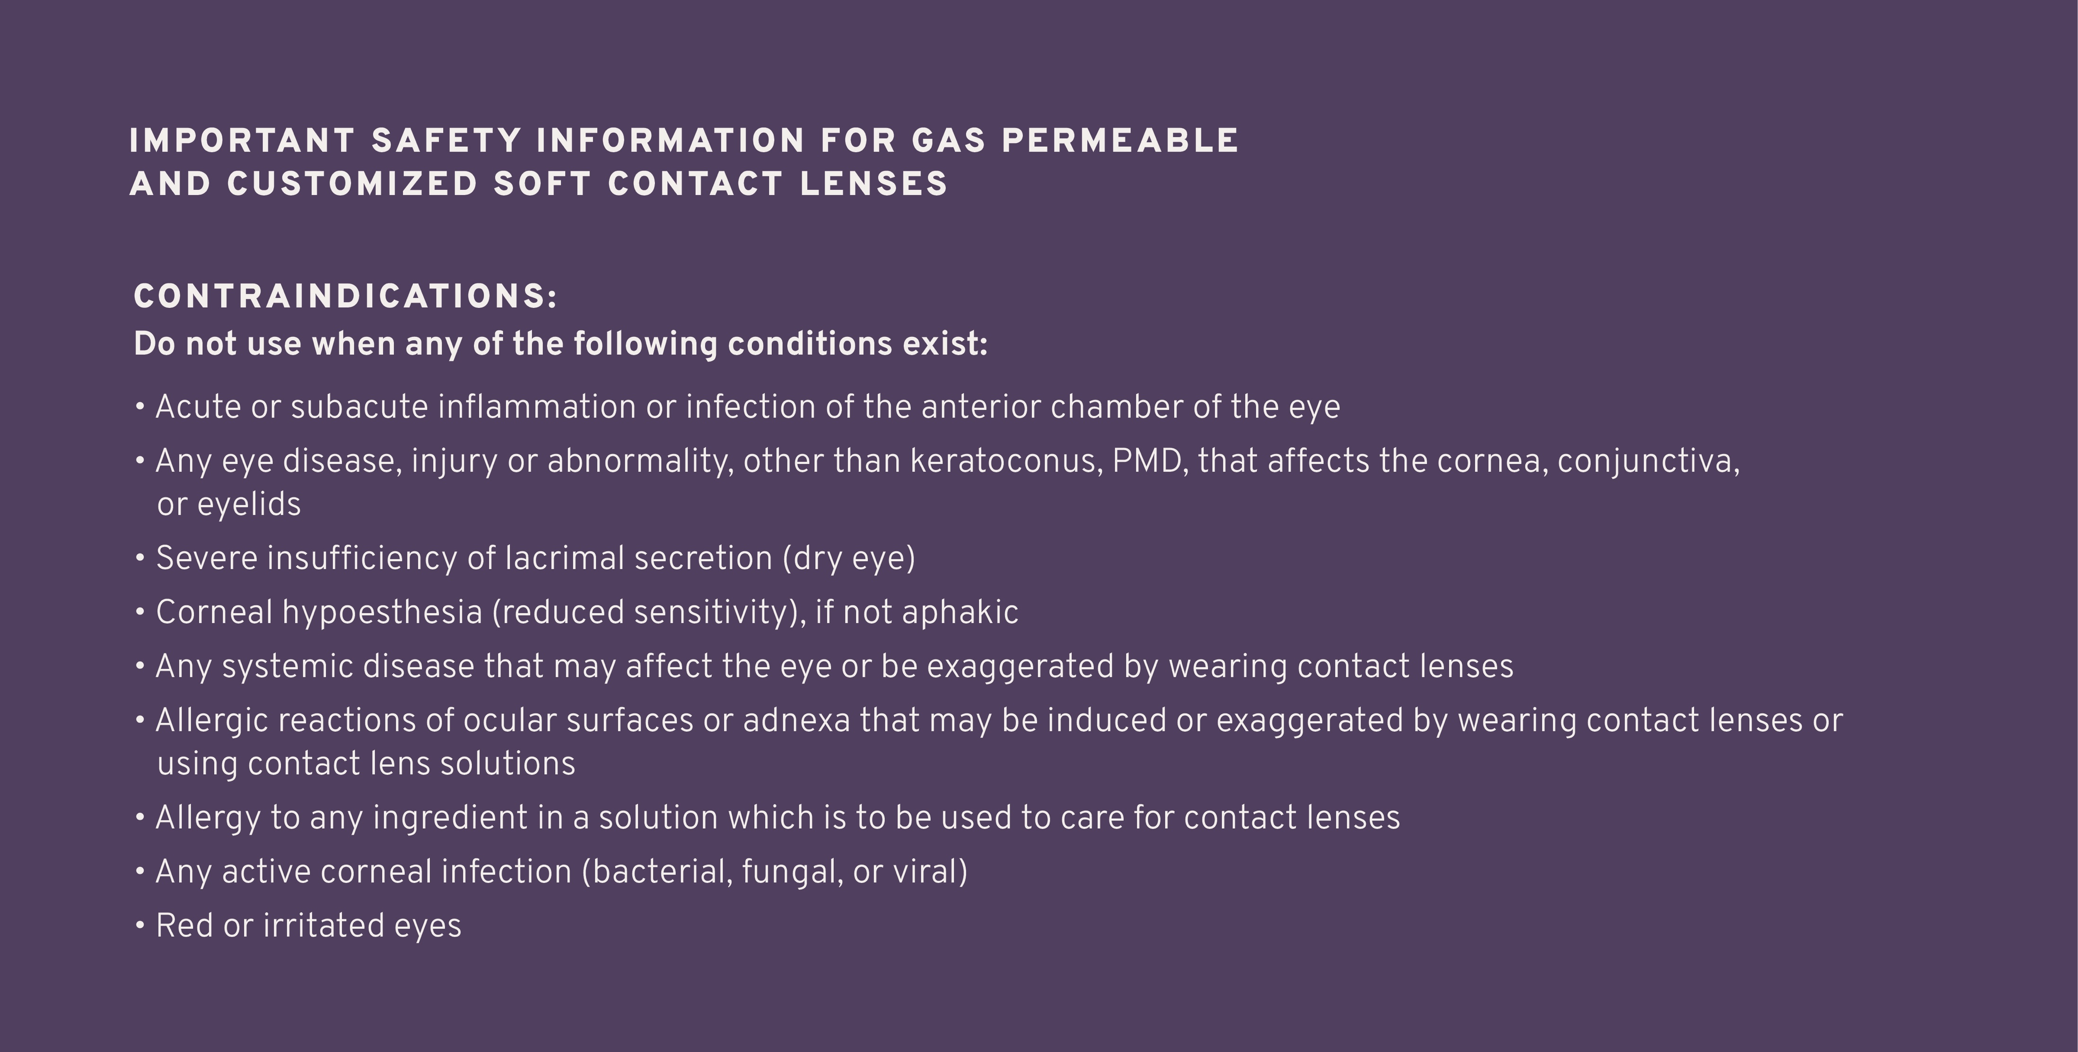
Notes:
Speak to slide.

Slide 25
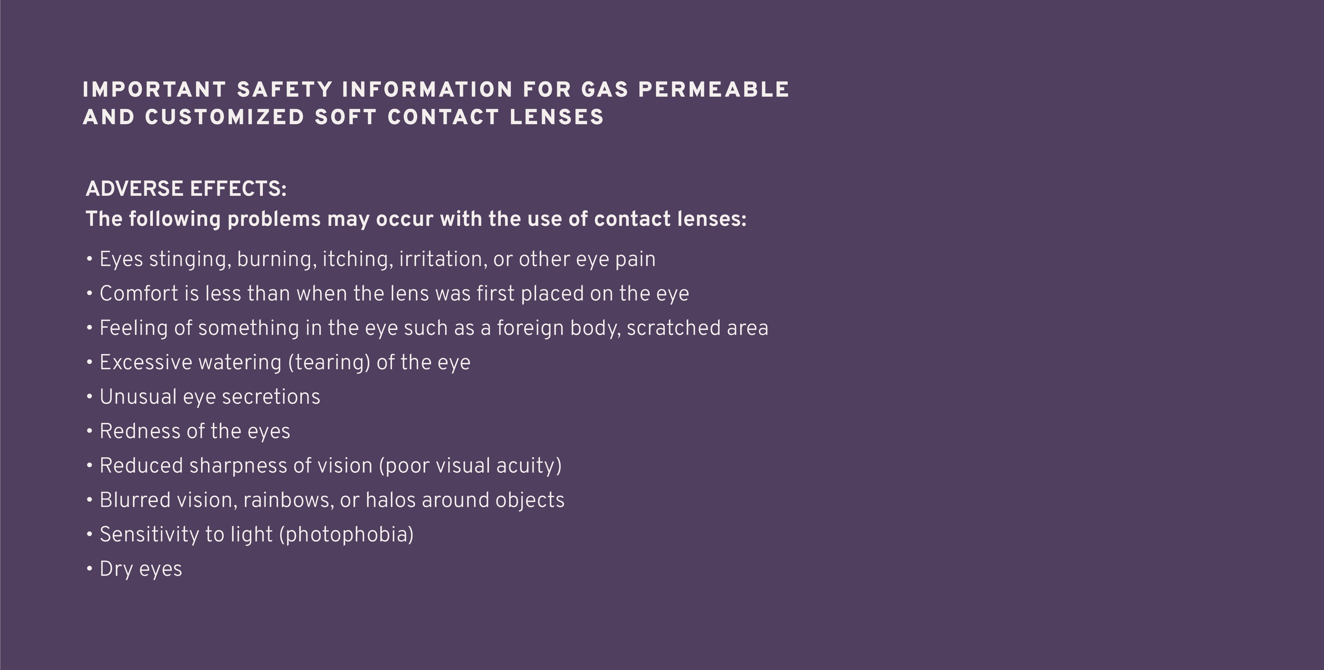
Notes:
Speak to slide.

Slide 26

Thank you!
®/™ are trademarks of Bausch & Lomb Incorporated or its affiliates.
©2022 Bausch & Lomb Incorporated or its affiliates. MTB.0189.USA.22
CONFIDENTIAL — DO NOT PRINT OR COPY — THESE MATERIALS ARE FOR YOUR VIEWING ONLY AND ARE NOT INTENDED FOR DISTRIBUTION; FOR PRESENTATION PURPOSES ONLY.
Notes:
Thank you!

